Slide 1
Item Response Theory
Using
Bayesian Networks by
Richard Neapolitan

Slide 2
I will follow the Bayesian network approach to IRT forwarded by Almond and Mislevy:
http://ecd.ralmond.net/tutorial/
A good tutorial that introduces basic IRT is provided at the following site:
http://www.creative-wisdom.com/multimedia/ICHA.htm

Slide 3
Let Θ represent arithmetic ability.
Θ is called a proficiency.
We have the following items to test Θ:
Item | Task
1 (easiest) | 2 + 2
2 | 16 - 12
3 | 64 x 27
4 | 673 x 515
5 (hardest) | 105,110 / 67

Slide 4
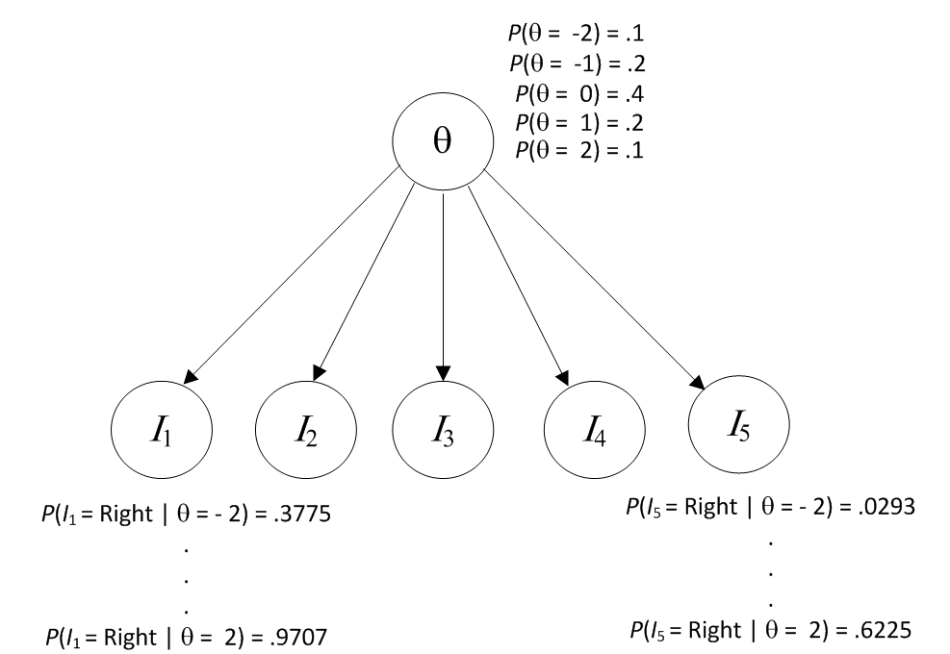
0 represents average ability.
-2 is the lowest ability.
2 is the highest ability.
We assume performance on items is independent given the ability.

Slide 6
IRT Logistic Evidence Model
b_{i} measures the difficulty of the item.

Slide 7
b = 0 (average difficulty)

Slide 8
b = - 1.5 (easy item)

Slide 9
b = 1.5 (hard item)

Slide 10
Discrimination Parameter: a

Slide 11
a = 5, b = 0

Slide 12
a = .5, b = 0

Slide 13
a = 5, b = 1.5

Slide 14
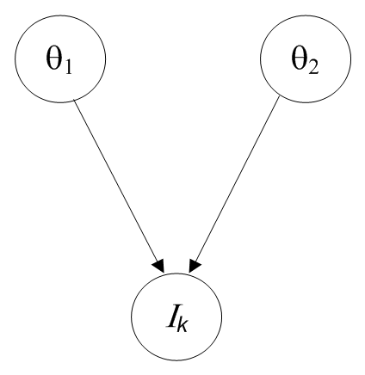
Two Proficiency Models

Slide 15
Two Proficiency Models
Compensatory:
More of Proficiency 1 compensates for less of Proficiency 2.
Combination rule is sum.
Conjunctive:
Both proficiencies are needed to solve the problem.
Combination rule is minimum.
Disjunctive:
Two proficiencies represent alternative solution paths to the problem.
Combination rule is maximum.

Slide 18
Mixed Number Subtraction
This example is drawn from the research of Tatsuoka (1983) and her colleagues. Almond and MsLevy (2012) did the analysis.
Their work began with cognitive analyses of middle-school students’ solutions of mixed-number subtraction problems.
Klein et al. (1981) identified two methods that students used to solve problems in this domain:
• Method A: Convert mixed numbers to improper fractions, subtract, then reduce if necessary
• Method B: Separate mixed numbers into whole number and fractional parts; subtract as two subproblems, borrowing one from minuend whole number if necessary; then simplify and reduce if necessary.

Slide 19
Their analysis concerns the responses of 325 students Tatsuoka identified as using Method B to fifteen items in which it is not necessary to find a common denominator.
The items are grouped in terms of which of the following procedures is required for a solution under Method B:
Skill 1: Basic fraction subtraction.
Skill 2: Simplify/reduce fraction or mixed number.
Skill 3: Separate whole number from fraction.
Skill 4: Borrow one from the whole number in a given mixed number.
Skill 5: Convert a whole number to a fraction.
All models are conjunctive.

Slide 20
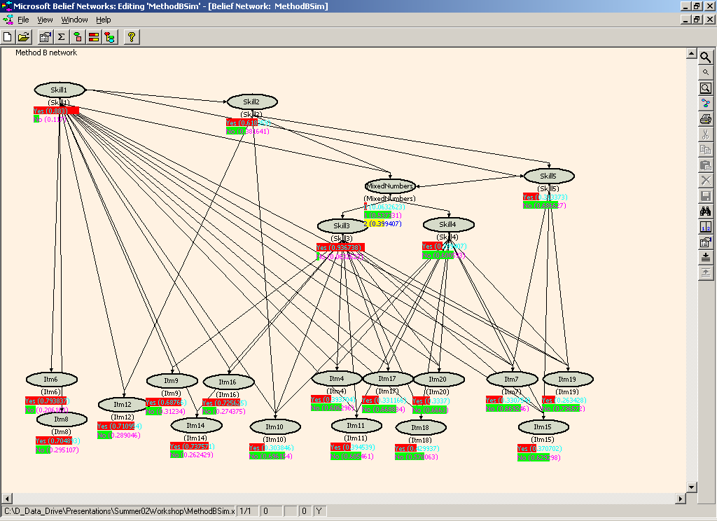

Slide 21
Learning Parameters From Data

Slide 22
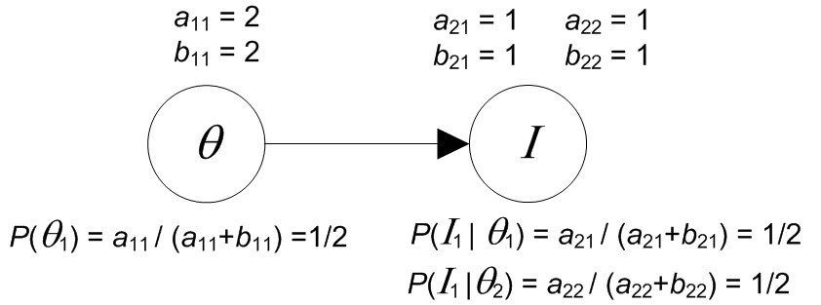
Learning From Complete Data
We use Dirichlet distributions to represent our belief about the parameters.
In our hypothetical prior sample,
  a₁₁ is the number of times Θ tooks its first value.
  b₁₁ is the number of times Θ took its second value.
  a₂₁ is the number of times I took its first value when Θ took its first value.
  b₂₁ is the number of times I took its second value when Θ took its first value.

Slide 23
Θ | I
1 | 1
1 | 1
1 | 2
2 | 1
2 | 1
2 | 2
2 | 2
2 | 2
Suppose we have the data in the table above.
a₁₁ = a₁₁ + 3 = 2 + 3 = 5 b₁₁ = b₁₁ + 5 = 2 + 5 = 7
P(Θ₁ ) = 5/12
a₂₁ = a₂₁ + 2 = 1 + 2 = 3 b₂₁ = b₂₁ + 1 = 1 + 1 = 2
P(I₁ | Θ₁) = 3/5

Slide 24
Θ | I
? | 1
? | 1
? | 2
? | 1
? | 1
? | 2
? | 2
? | 2
But we don’t have data on the proficiency.
We then use algorithms that learn when there is missing data.
Markov Chain Monte Carlo (MCMC).
Expectation Maximization (EM).

Slide 25
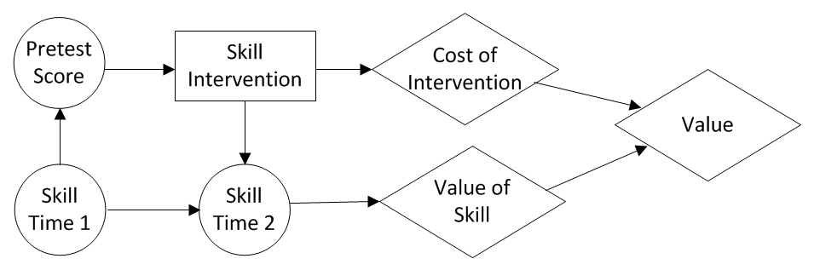
Influence Diagrams

Slide 26
Standard IRT
In traditional applications of IRT there usually is one proficency Θ and a set of items.
A normal prior is placed on Θ.
The parameters a and b in the logistic function are learned from data.
The model is then used to do inference for the next case.

